Slide 2
Microsoft Project 2010 Ignite Training- Conclusion
Christophe Fiessinger & Jan Kalis
Senior Technical Product Manager
Microsoft Corporation
chrisfie@microsoft.com jkalis@microsoft.com

Slide 3
Agenda
Project 2010
Ignite Summary
Certification
Key Microsoft Project Resources
Share the Excitement
Feedback

Slide 4




Project 2010 Investment Areas Work Management Solutions for Individuals, Teams and the Enterprise
Unified Project and Portfolio Management
Common experience across full PPM lifecycle
Flexible project capture and initiation
Enhance governance through workflow
Powerful portfolio selection analytics
Simple and Intuitive User Experience
Fluent UI (Ribbon, Backstage view)
Intuitive Excel-like behavior
Timeline & Team Planner views
Web-based project editing
Enhanced Collaboration & Reporting
Connect teams with SharePoint Sync
Built on SharePoint Server 2010
Better time and status reporting
Easily create reports and dashboards
Scalable and Connected Platform
Extend interoperability
Simplified administration
Rich platform services
Developer Productivity

Slide 5


Microsoft SharePoint 2010
Ribbon UI
SharePoint Workspace
SharePoint Mobile
Office Client and Office Web App Integration
Standards Support
Business Connectivity Services
InfoPath Form Services
External Lists
Workflow
SharePoint Designer
Visual Studio
API Enhancements
REST/ATOM/RSS
Sites
Tagging, Tag Cloud, Ratings
Social Bookmarking
Blogs and Wikis
My Sites
Activity Feeds
Profiles and Expertise
Org Browser
Composites
Communities
Project Server 2010 is built on SharePoint 2010
-> Explore Coexistence Opportunities
PerformancePoint Services
Excel Services
Chart Web Part
Visio Services
Web Analytics
SQL Server Integration
PowerPivot
Insights
Content
Search
Enterprise Content Types
Metadata and Navigation
Document Sets
Multi-stage Disposition
Audio and Video Content Types
Remote Blob Storage
List Enhancements
Social Relevance
Phonetic Search
Navigation
FAST Integration
Enhanced Pipeline

Slide 6

Project 2010 Ignite Summary
Day 1 – Overview and Deployment
Introduction
Project 2010 Overview
Planning and Design
Deployment and Upgrade
Day 2 – Key Investments
Demand Management
Portfolio Strategy
Timesheet and Statusing
Reporting
Day 3 – Operation and Extensibility
Administration
Operations
Customization
Conclusion

Slide 7
Certification
2007 WAVE
2010 WAVE FY10
IN PLAN 2010 WAVE FY11
PROJECT CLIENT
Course 5927A: Microsoft Office Project 2007, Managing Projects
Partner built content : Microsoft Project 2010, Managing Projects
Future Achievement Exam: Microsoft Project 2010, Developing applications
Microsoft Certified Technology Specialist exam, Exam 70-632: TS: Microsoft Office Project 2007, Managing Projects
Achievement Exam: Exam 74-178: Project 2010, Managing Projects
PROJECT SERVER
Course 5928A: Microsoft Office Project Server 2007, Managing Projects
Partner built content : Microsoft Project Server 2010, Managing Projects
Future Achievement Exam: Microsoft Project Server 2010, Developing applications
Microsoft Certified Technology Specialist exam, Exam 70-633: TS: Microsoft Office Project Server 2007, Managing Projects
Achievement Exam :
Exam 74-177: Project Server 2010,Architecting, Installing and Configuring
Future Achievement Exam: Microsoft Project Server 2010, Advanced Portfolio Configuration
Course 5929: Microsoft Office Project Server 2007, Managing Projects and Programs
Partner built content : Microsoft Project Server 2010, Managing Projects and Programs
Future Achievement Exam: Microsoft Project Online 2010, Configuration and Development
Microsoft Certified Professional (PRO) exam, Exam 70-634: PRO: Microsoft Office Project Server 2007, Managing Projects and Programs
Achievement Exam :
Exam 74-177: Project Server 2010,Architecting, Installing and Configuring
KEY:
MICROSOFT BUILT
Exam 70-639: TS: Microsoft Office Project Server 2007, Configuring
Achievement Exam :
Exam 74-177: Project Server 2010,Architecting, Installing and Configuring
PARTNER BUILT

Slide 8
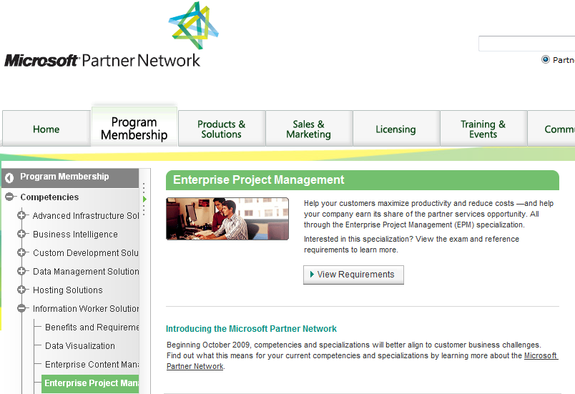
Partner Portal
https://partner.microsoft.com/global/program/competencies/iwsolutions/epm

Slide 9



EPM Solutions and Scenarios Gain Additional Value From The Microsoft Platform
http://www.microsoft.com/project/en/us/scenarios-solutions.aspx
Project Portfolio Management (PPM)
Innovation Process Management (IPM)
Application Life-Cycle Management (ALM)
CPIC & Strategic Planning & Governance
Email proj2007@microsoft.com for Project Virtual Machine Download Instructions

Slide 10
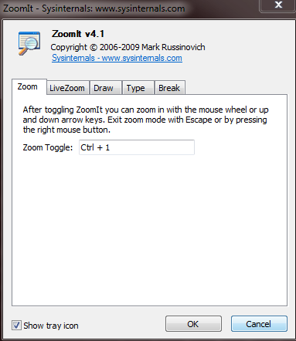
ZoomIt For All Your Demos
http://technet.microsoft.com/en-us/sysinternals/bb897434.aspx

Slide 11

Key Microsoft Project Resources
Enterprise Project Management Microsoft Project Main Project marketing site EPM Solutions and Scenarios Microsoft EPM Partner Portal Find a Partner Worldwide locations |  | Project Desktop Microsoft Project on Office Online Easier with Project: Project Desktop Home Page
IT Professionals /Administrators - TechNet Project TechCenter (2007, 2010…) |  | Developers - MSDN Project Developer Home Page
Blogs
Team Blogs | Individual Blogs
Project Team Project Programmability Project Administration EPM Content Publishing News SharePoint Team | Brian Smith – Project Support Doug McBlog – Project Partners Christophe Fiessinger – Project News And a dozen more non Microsoft, MPUG… Bing them!
Forums Ask A Question Twitter http://twitter.com/MSFTProject Facebook Microsoft Project Videos www.youtube.com/MSFTProject

Slide 12
Share the Excitement
Share the Microsoft Project 2010 content, capabilities demos with:
Peers
Customers
Relatives
Neighbors…
Blog, Tweet, Facebook, webcast…
Tell us about it!

Slide 13
Feedback
Your feedback and participation is welcomed and needed!
Please complete all questions from both surveys

Slide 14
Next Steps
Download and Install Public Beta
Read all TechNet and MSDN 2010 documentation
Ask Questions on Project 2010 Forums
Ramp up on SharePoint 2010
http://sharepoint2010.microsoft.com/Pages/default.aspx
http://technet.microsoft.com/en-us/sharepoint/ee263917.aspx
http://msdn.microsoft.com/en-us/sharepoint/ee514561.aspx

Slide 15

© 2009 Microsoft Corporation. All rights reserved. Microsoft, Windows, Windows Vista and other product names are or may be registered trademarks and/or trademarks in the U.S. and/or other countries.
The information herein is for informational purposes only and represents the current view of Microsoft Corporation as of the date of this presentation. Because Microsoft must respond to changing market conditions, it should not be interpreted to be a commitment on the part of Microsoft, and Microsoft cannot guarantee the accuracy of any information provided after the date of this presentation. MICROSOFT MAKES NO WARRANTIES, EXPRESS, IMPLIED OR STATUTORY, AS TO THE INFORMATION IN THIS PRESENTATION.

